Slide 1
Comparative Text Analysis of Redmi Note 10 Pro’s Amazon and Flipkart Reviews
Preetam Saha
C22018
Praxis business school
PGPDS-Jan’22

Slide 2
Business Problem
E-commerce websites like amazon and flipkart always have a neck to neck competition specially in festive seasons.
Customers always try to have their demanding products at optimal price with considering the quality of those products.
Before buying a product customers always analysis the reviews regarding that products.
At the same time from company’s point of view its important to analysis those customers’ review to keep ahead in market by acquiring and retaining maximum number of customers
Also, by forecasting the demand, ratings of the future products beforehand Company can always apply elastic pricing and flattening the demand curve.

Slide 3
Data collection
As a data scientist, first and foremost task is to collect the data for any kind of analysis to solve a business problem.
Here, I have web scrapped the top 500 reviews of Redmi note 10 pro from amazon and flipkart website
Using beautifulsoup and selenium
I have taken data for dates, reviews and ratings columns and converted them all into a pandas data frame
Then finally stored the data into two excel files separately named as
amazon_redmi_note_10_pro_20220920.xlsx
flipkart_redmi_note_10_pro_20220920.xlsx

Slide 4
Challenges of Data collection
Rating tags were same for all 5 in amazon whereas for 3 , 4 , 5 star ratings tags were same but for 2 and 1 star ratings were different
Ratings and dates were not that straight-fowardedly extracted, I have done some pre processing on dates and ratings columns. Using datetime function and regex I have handled those problems
Dates format were different for amazon and flipkart and those were handled by different techniques.

Slide 5
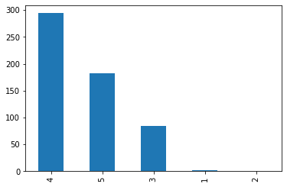
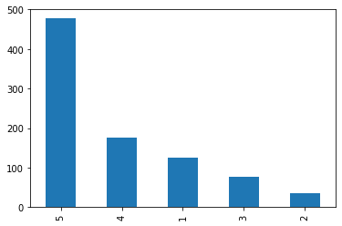
Distribution of ratings
Amazon Flipkart
out of 500, 1 and 2 star almost negligible out of 678, 1 star rating is at 3rd position

Slide 6
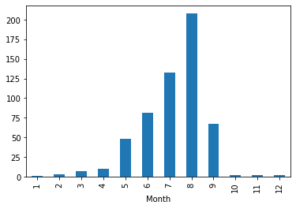
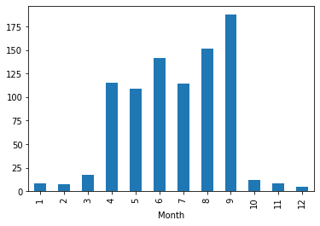
Number of ratings based on months
Amazon Flipkart
Max rating was given at august, followed by Max at September, and quite high during April to July September

Slide 7
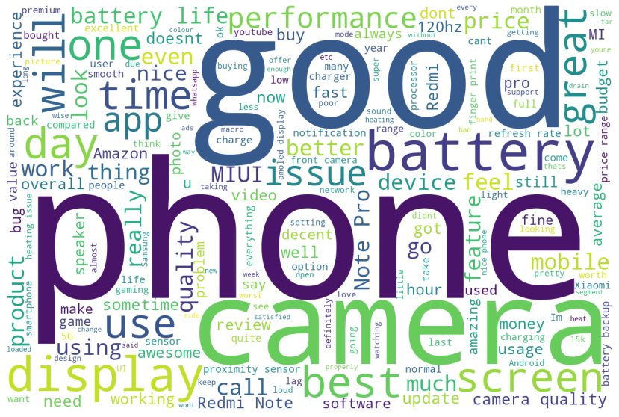
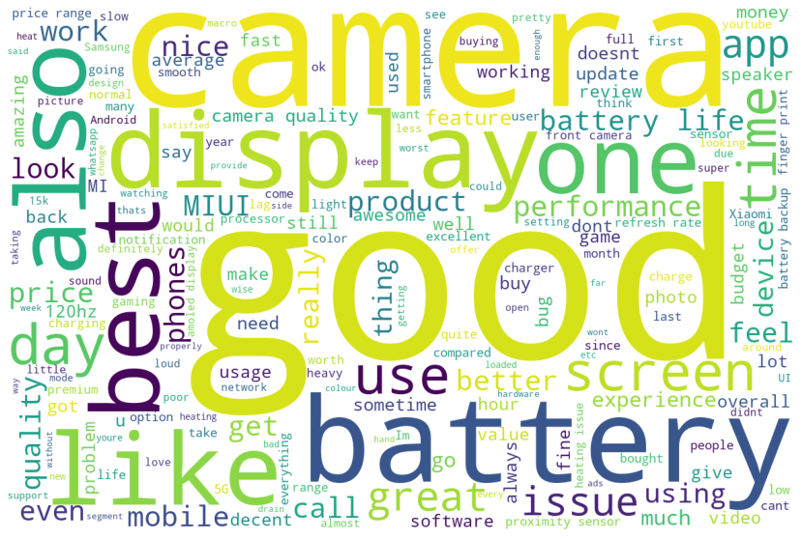
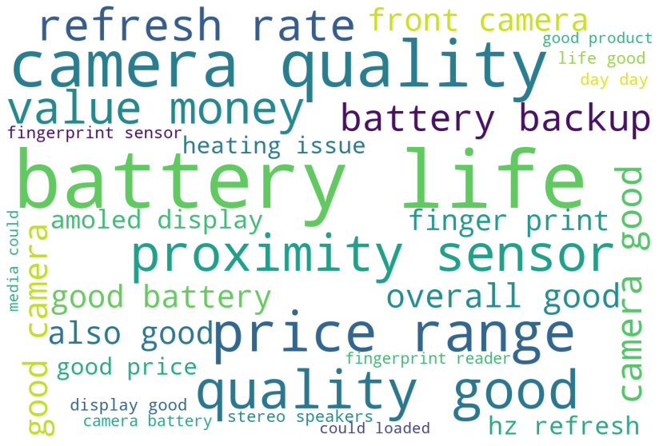
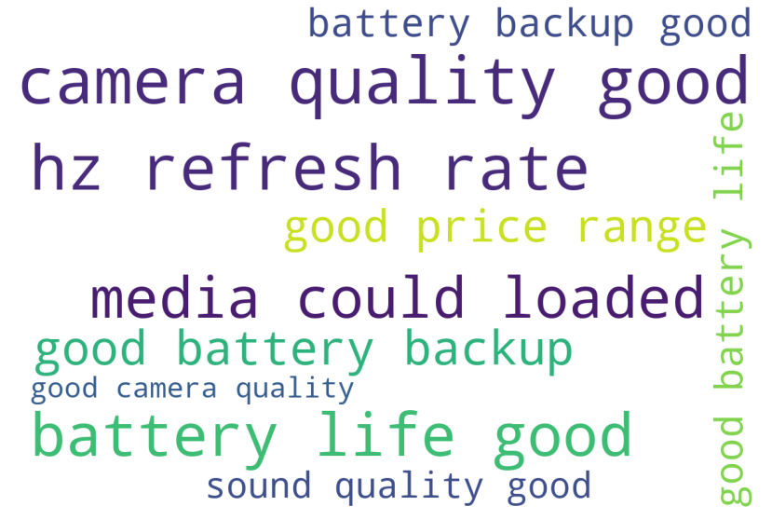
Analysis
WordCloud for Amazon
Using normal nltk STOPWORDS | Excluding redmi , phone, pro etc | Excluding redmi , phone, pro etc and Ngram_range=(2,2) | Excluding redmi , phone, pro etc and Ngram_range=(3,3)
Key features:
Good camera quality
Good battery backup
Good price range
Good sound quality

Slide 8
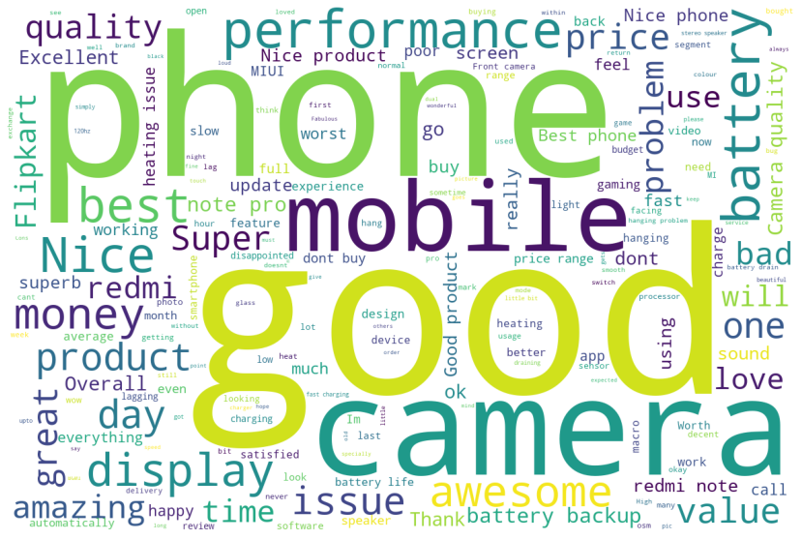
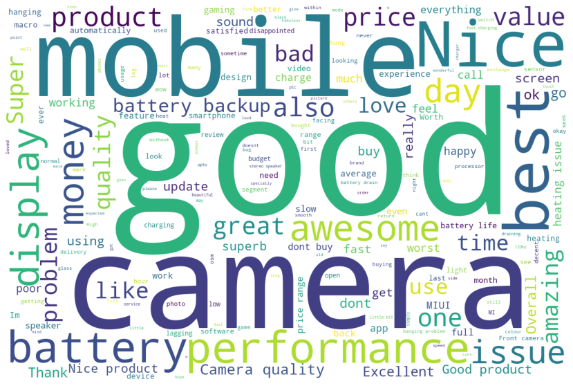
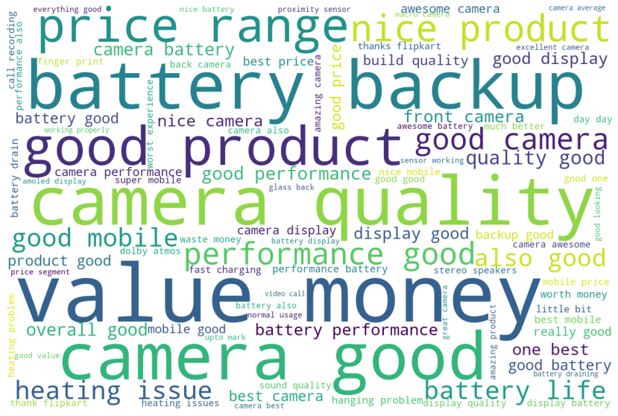
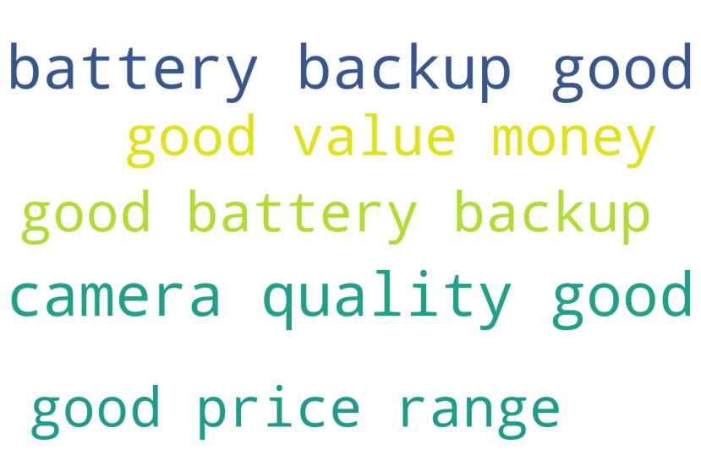
Analysis
1.b.WordCloud for Flipkart
Using normal nltk STOPWORDS | Excluding redmi , phone, pro etc | Excluding redmi , phone, pro etc and Ngram_range=(2,2) | Excluding redmi , phone, pro etc and Ngram_range=(3,3)
Key features:
Good camera quality
Good battery backup
Good price range

Slide 9
2.a. Gensim Word2Vec for Amazon
model.wv.most_similar("camera") [('good', 0.3559267222881317), ('very', 0.33170798420906067), ('is', 0.2978816032409668), ('clicks', 0.2908284664154053), ('glass', 0.2826727032661438), ('quick', 0.27812618017196655), ('view', 0.2657555639743805), ('yet', 0.2524731457233429), ('cam', 0.2514335513114929), ('specially', 0.25141286849975586)] model.wv.similarity(w1="app",w2="whatsapp") 0.17154303 | model.wv.most_similar("whatsapp") [('part', 0.3023599684238434), ('does', 0.29837462306022644), ('voice', 0.28285786509513855), ('show', 0.27509409189224243), ('rest', 0.2677491009235382), ('mode', 0.2629464268684387), ('well', 0.25770968198776245), ('body', 0.25731006264686584), ('speaker', 0.2572937309741974), ('keeps', 0.2534657120704651)] model.wv.similarity(w1="hour",w2="playing") 0.104633376 | model.wv.most_similar("battery") [('is', 0.3501793444156647), ('clearly', 0.233858123421669), ('annoying', 0.23279905319213867), ('and', 0.21471013128757477), ('quality', 0.2104824185371399), ('with', 0.20468685030937195), ('on', 0.20275898277759552), ('disappointed', 0.19996562600135803), ('pros', 0.19201186299324036), ('but', 0.18972858786582947)] model.wv.similarity(w1="good",w2="high") 0.021358076 | model.wv.most_similar("game") [('bgmi', 0.4011242687702179), ('played', 0.3173946142196655), ('graphics', 0.29895952343940735), ('to', 0.2866517901420593), ('closing', 0.2766624093055725), ('heard', 0.2761889398097992), ('opening', 0.2755500078201294), ('pubg', 0.26764482259750366), ('twice', 0.2654443681240082), ('laggy', 0.2640998959541321)] model.wv.similarity(w1="camera",w2="picture") 0.19587046
Sin
Since, data points are only 500 here, so that not much significant similarity scores between two words.
Also, most similar words are also not that relevant in that word’s context.
So, increasing the number of reviews may give some better results

Slide 10
2.b. Gensim Word2Vec for Flipkart
model.wv.most_similar("camera") [('good', 0.3418322503566742), ('is', 0.3417450189590454), ('backup', 0.27652472257614136), ('quite', 0.2742314040660858), ('performance', 0.2668933868408203), ('and', 0.25507935881614685), ('high', 0.24734073877334595), ('very', 0.23515333235263824), ('build', 0.2349652796983719), ('glass', 0.22478815913200378)] model1.wv.similarity(w1="money",w2="budget") -0.044924334 | model.wv.most_similar("whatsapp") [('part', 0.3023599684238434), ('does', 0.29837462306022644), ('voice', 0.28285786509513855), ('show', 0.27509409189224243), ('rest', 0.2677491009235382), ('mode', 0.2629464268684387), ('well', 0.25770968198776245), ('body', 0.25731006264686584), ('speaker', 0.2572937309741974), ('keeps', 0.2534657120704651)] model1.wv.similarity(w1="app",w2="processor") -0.018741116 | model.wv.most_similar("battery") [('is', 0.334014356136322), ('fast', 0.3283764123916626), ('half', 0.24870842695236206), ('night', 0.24579885601997375), ('good', 0.21228183805942535), ('for', 0.20976561307907104), ('give', 0.20125436782836914), ('have', 0.20000585913658142), ('day', 0.1986600011587143), ('it', 0.1941145807504654)] model1.wv.similarity(w1="camera",w2="picture") 0.041205995 | model.wv.most_similar(“display”) [('back', 0.319588303565979), ('screen', 0.31506893038749695), ('range', 0.2982552647590637), ('amazing', 0.2477981448173523), ('is', 0.2354917675256729), ('must', 0.21434155106544495), ('loud', 0.20491507649421692), ('mode', 0.20227909088134766), ('two', 0.2019311487674713), ('osm', 0.19991883635520935)] model1.wv.similarity(w1="hour",w2="playing") 0.06202336
Sin
Since, data points are only 678 here, so that not much significant similarity scores between two words.
Also, most similar words are also not that relevant in that word’s context.
So, increasing the number of reviews may give some better results

Slide 11
LSA 3.a.Amazon
Concept 0
good camera battery quality quality good best price overall camera quality product life display mobile overall good also ==================================================================================================
Concept 1
nice camera product best battery quality nice product display mobile performance one like life camera quality price ==================================================================================================
Concept 2
nice good nice product quality nice products recommend services complete department hang based product good good mobile perfect dual stereo speakers ==================================================================================================
Concept 3
best budget k segment best price best budget smartphone mobile price nice one best good product rounder next ==================================================================================================
Concept 4
value money value money product best money product value money product still value still value money purchased recommend g still nice product lagging ==================================================================================================
Concept 5
product nice product good product excellent amazon like product good problem awesome service satisfied awesome product much price money product
==================================================================================================
Concept 6
quality camera quality product camera quality good camera quality good life battery life nice product average reader life good fingerprint battery life good good camera
==================================================================================================
Concept 7
like quality camera quality quality good camera quality good camera best good like could loaded media could media could loaded reader loaded media fingerprint reader
==================================================================================================
Concept 8
price good price range price range could loaded media could media could loaded loaded overall good awesome media could good price range overall camera ==================================================================================================
Concept 9
mobile price camera range good mobile good price price range camera quality quality best price awesome good price range better worth could ==================================================================================================

Slide 12
LSA 3.b.Flipkart
Concept 0
good nice product good product camera mobile good mobile performance battery quality camera good money awesome good camera best ==============================================================================================
Concept 1
nice nice product product nice camera camera like super value money mobile value nice mobile money camera nice love display ==============================================================================================
Concept 2
best money value money value camera awesome mobile battery product super performance display excellent quality price ==============================================================================================
Concept 3
product good product nice product best product good flipkart worst product worst amazing product love range thanks flipkart thanks satisfied amazing
==============================================================================================
Concept 4
money value money value product good product nice product excellent good value good value money worth money worth waste waste money mobile value mobile value money
==============================================================================================
Concept 5
awesome super product camera good product battery display performance nice product awesome camera bad camera quality love everything miui
==============================================================================================
Concept 6
super mobile good mobile super mobile camera quality superb super camera problem battery excellent product like budget great ==============================================================================================
Concept 7
super awesome best value money value money good super mobile smartphone nice best mobile range best price best smartphone g ==============================================================================================
Concept 8
mobile good mobile awesome best mobile nice mobile problem excellent hanging nice product superb buy mobile good really good fabulous super mobile
==============================================================================================
Concept 9
excellent excellent camera love super awesome best better camera performance exchange decent good product loved good one best nice ==============================================================================================

Slide 13
Spacy 4.a. Amazon
CAMERA
BATTERY
DISPLAY
[('battery', 'that much lasting as expected Overall its a good phone Excellent for mid rangers I like camera 55'), ('battery', 'pretty average'), ('battery', 'too slow')]
[('camera', 'important to you'), ('camera', 'very good'), ('camera', 'decent'), ('camera', 'not good'), ('camera', 'good'), ('camera', 'best'), ('camera', 'normal but'), ('camera', 'good as per the range of phone'), ('camera', 'awesome'), ('camera', 'good'), ('camera', 'awsome'), ('camera', 'avgCons1'), ('camera', 'better'), ('camera', 'so blurry and'), ('camera', 'worst'), ('camera', 'beautiful'), ('camera', 'okayish')]
[('display', 'very great'), ('display', 'nice'), ('display', 'amazing'), ('display', 'good')]
PERFORMANCE
SPEAKERS
[('speakers', 'really loud'), ('speakers', 'sufficiently loud'), ('speakers', 'decent'), ('speakers', 'too good for this price range'), ('speakers', 'that much loud as expected If you are a normal user who does nt play games like pung'), ('speakers', 'great'), ('speakers', 'so awesome')]
[('performance', 'good but'), ('performance', 'slow'), ('performance', 'that much Satisfied with camera battery life n'), ('performance', 'fine'), ('performance', 'really great'), ('performance', 'more worthy Camera is not'), ('performance', 'very nice')]

Slide 14
Spacy 4.b. flipkart
PERFORMANCE
BATTERY
[('performance', 'good'), ('performance', 'very good'), ('performance', 'very nice'), ('performance', 'satisfactory'), ('performance', 'awesome but due to MIUI'), ('performance', 'ultimate'), ('performance', 'super quick'), ('performance', 'ok'), ('performance', 'very low I'), ('performance', 'very good'), ('performance', 'very bad'), ('performance', 'very decent'), ('performance', 'good'), ('performance', 'very good'), ('performance', 'good')]
DISPLAY
[('battery', 'decent'), ('battery', 'not excellent'), ('battery', 'very good'), ('battery', 'ok '), ('battery', 'Not satisfied Ordinary camera Very disappointed Charging time problem and wifi connectivity issues And charging time 2hours above Bad time After only 2 days mobile hanging repeated Some feature not in mobile Not buy this mobile Excellent mobile Value for')]
[('display', 'good'), ('display', 'good’)]
CAMERA
[('camera', 'not upto the mark'), ('camera', 'osm'), ('camera', 'good'), ('camera', 'nice'), ('camera', 'Totally satisfied '), ('camera', 'too good'), ('camera', 'so good it is over saturated'), ('camera', 'average'), ('camera', 'good'), ('camera', 'good'), ('camera', 'ok'), ('camera', 'worst'), ('camera', 'great'), ('camera', 'good')]

Slide 15
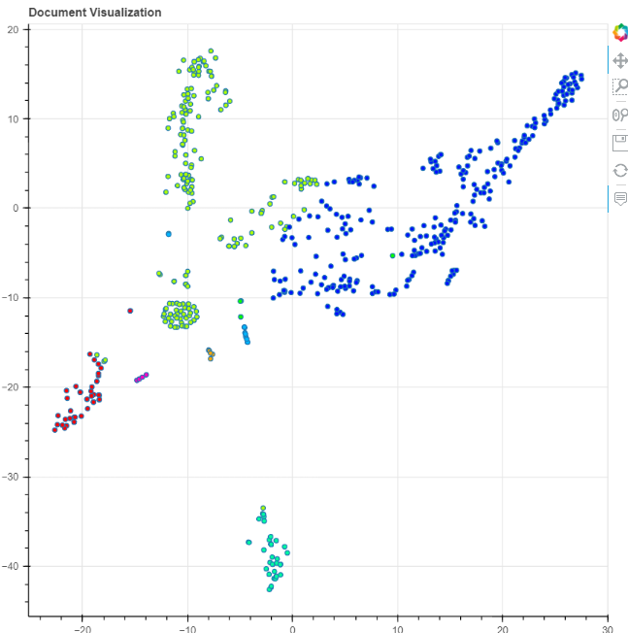
LDA 5.a.Amazon
topic:6 | count:256 | phone good camera battery display pro redmi screen like price
topic:2 | count:187 | good camera quality battery phone awesome life fingerprint finger print
topic:0 | count:47 | nice product good problem amazon card phone overall mobile come
topic:4 | count:38 | money value best phone smartphone good recording product processor thing
topic:5 | count:11 | good loaded media worth battery camera phone lagging life level
topic:1 | count:5 | phone good issues network facing camera battery superb time using
topic:8 | count:4 | perfect good phone storage price range camera problem battery excellent
topic:3 | count:4 | automatically good bug phone work battery camera does getting nice
topic:9 | count:2 | good nice best phone camera money battery product value range
Latent Dirichlet Allocation (LDA) is an example of topic model and is used to classify text in a document to a particular topic. Unlike lsa this is non linear
For lda, I have used the ktrain module in python

Slide 16
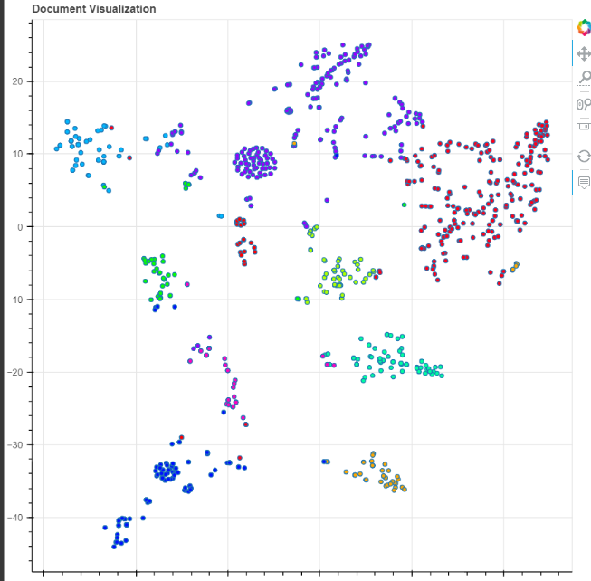
LDA 5.b. Flipkart
topic:9 | count:215 | camera phone battery best quality redmi display price issue note
topic:7 | count:205 | good phone camera battery performance awesome backup mobile quality display
topic:6 | count:103 | nice phone super best budget amazing getting think product superb
topic:4 | count:65 | phone just love time nice great wow sensor update working
topic:5 | count:64 | money value excellent worth working phone properly simply waste product
topic:2 | count:51 | bad hanging problem phone hang open slow apps osm calling
topic:8 | count:51 | product low good nice exchange expected beautiful perfect camera click
topic:3 | count:46 | mobile superb great camera bugs super automatically month old updates
topic:1 | count:45 | worst flipkart happy experience thank smartphone product thanks device service
topic:0 | count:28 | better phone experience awesome nice app display using speaker slow

Slide 17
Performance 5.a. Amazon
We applied 3 classification algorithms-logistic regression, Gradient Boost and support vector machine to predict the accuracy of our training dataset reviews.
Ml algorithms cannot work with text so we first applied tfidf vectorization of the reviews.
It is a sparse matrix, so we then then applied truncated svd (with 150 aspects) to get the review aspect matrix.
Cohen kappa score of
Lr = 0.016371885068051872
Lr=0.04017857142857151(with truncated svd)
GBM = 0.09289617486338797(with truncated svd)

Slide 18
Performance 5.b. Flipkart
We applied 3 classification algorithms-logistic regression, Gradient Boost and support vector machine to predict the accuracy of our training dataset reviews.
Ml algorithms cannot work with text so we first applied tfidf vectorization of the reviews.
It is a sparse matrix, so we then then applied truncated svd (with 150 aspects) to get the review aspect matrix.
Cohen kappa score of
Lr = 0.24965936187123883
Lr=0.2543402527855353 (with truncated svd)
GBM = 0.19431833627837436 (with truncated svd)

Slide 19
Conclusion
As we have less number of reviews for only 1 phone, we found no significant difference between in reviews between the 2 websites.
Most of the reviews are overwhelmingly positive in both the websites
They talk about aspects of the phone like battery and camera. They talk about how the phone is a good buy and worth its price
Good camera quality
Good battery backup
Good price range
The algorithms like lsa and lda has found topics based on the reviews, but the topics they found are hardly different from each other.
Using aspects from truncated svd gives slightly better results in terms of models accuracy

Slide 20
Thank You

